Slide 1
UX design inspirations- Connect Modules

Slide 2
Background
Background https://docs.google.com/presentation/d/1-92xZg0lzt2mSLrhWgZ07j9LlyXjrFll5z3-NnruDMY/edit?usp=sharing
Crazy Eights https://docs.google.com/presentation/d/1KrUcaB0qdM4cJchJvJ2QvRaC_591Vj9tuczC6OH4lYs/edit?usp=sharing

Slide 3
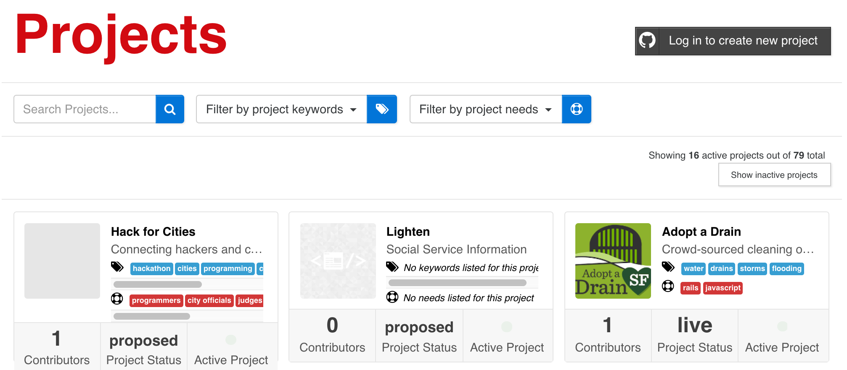
Current Project List

Slide 4
Connect Options- Likes, Messages, etc

Slide 5
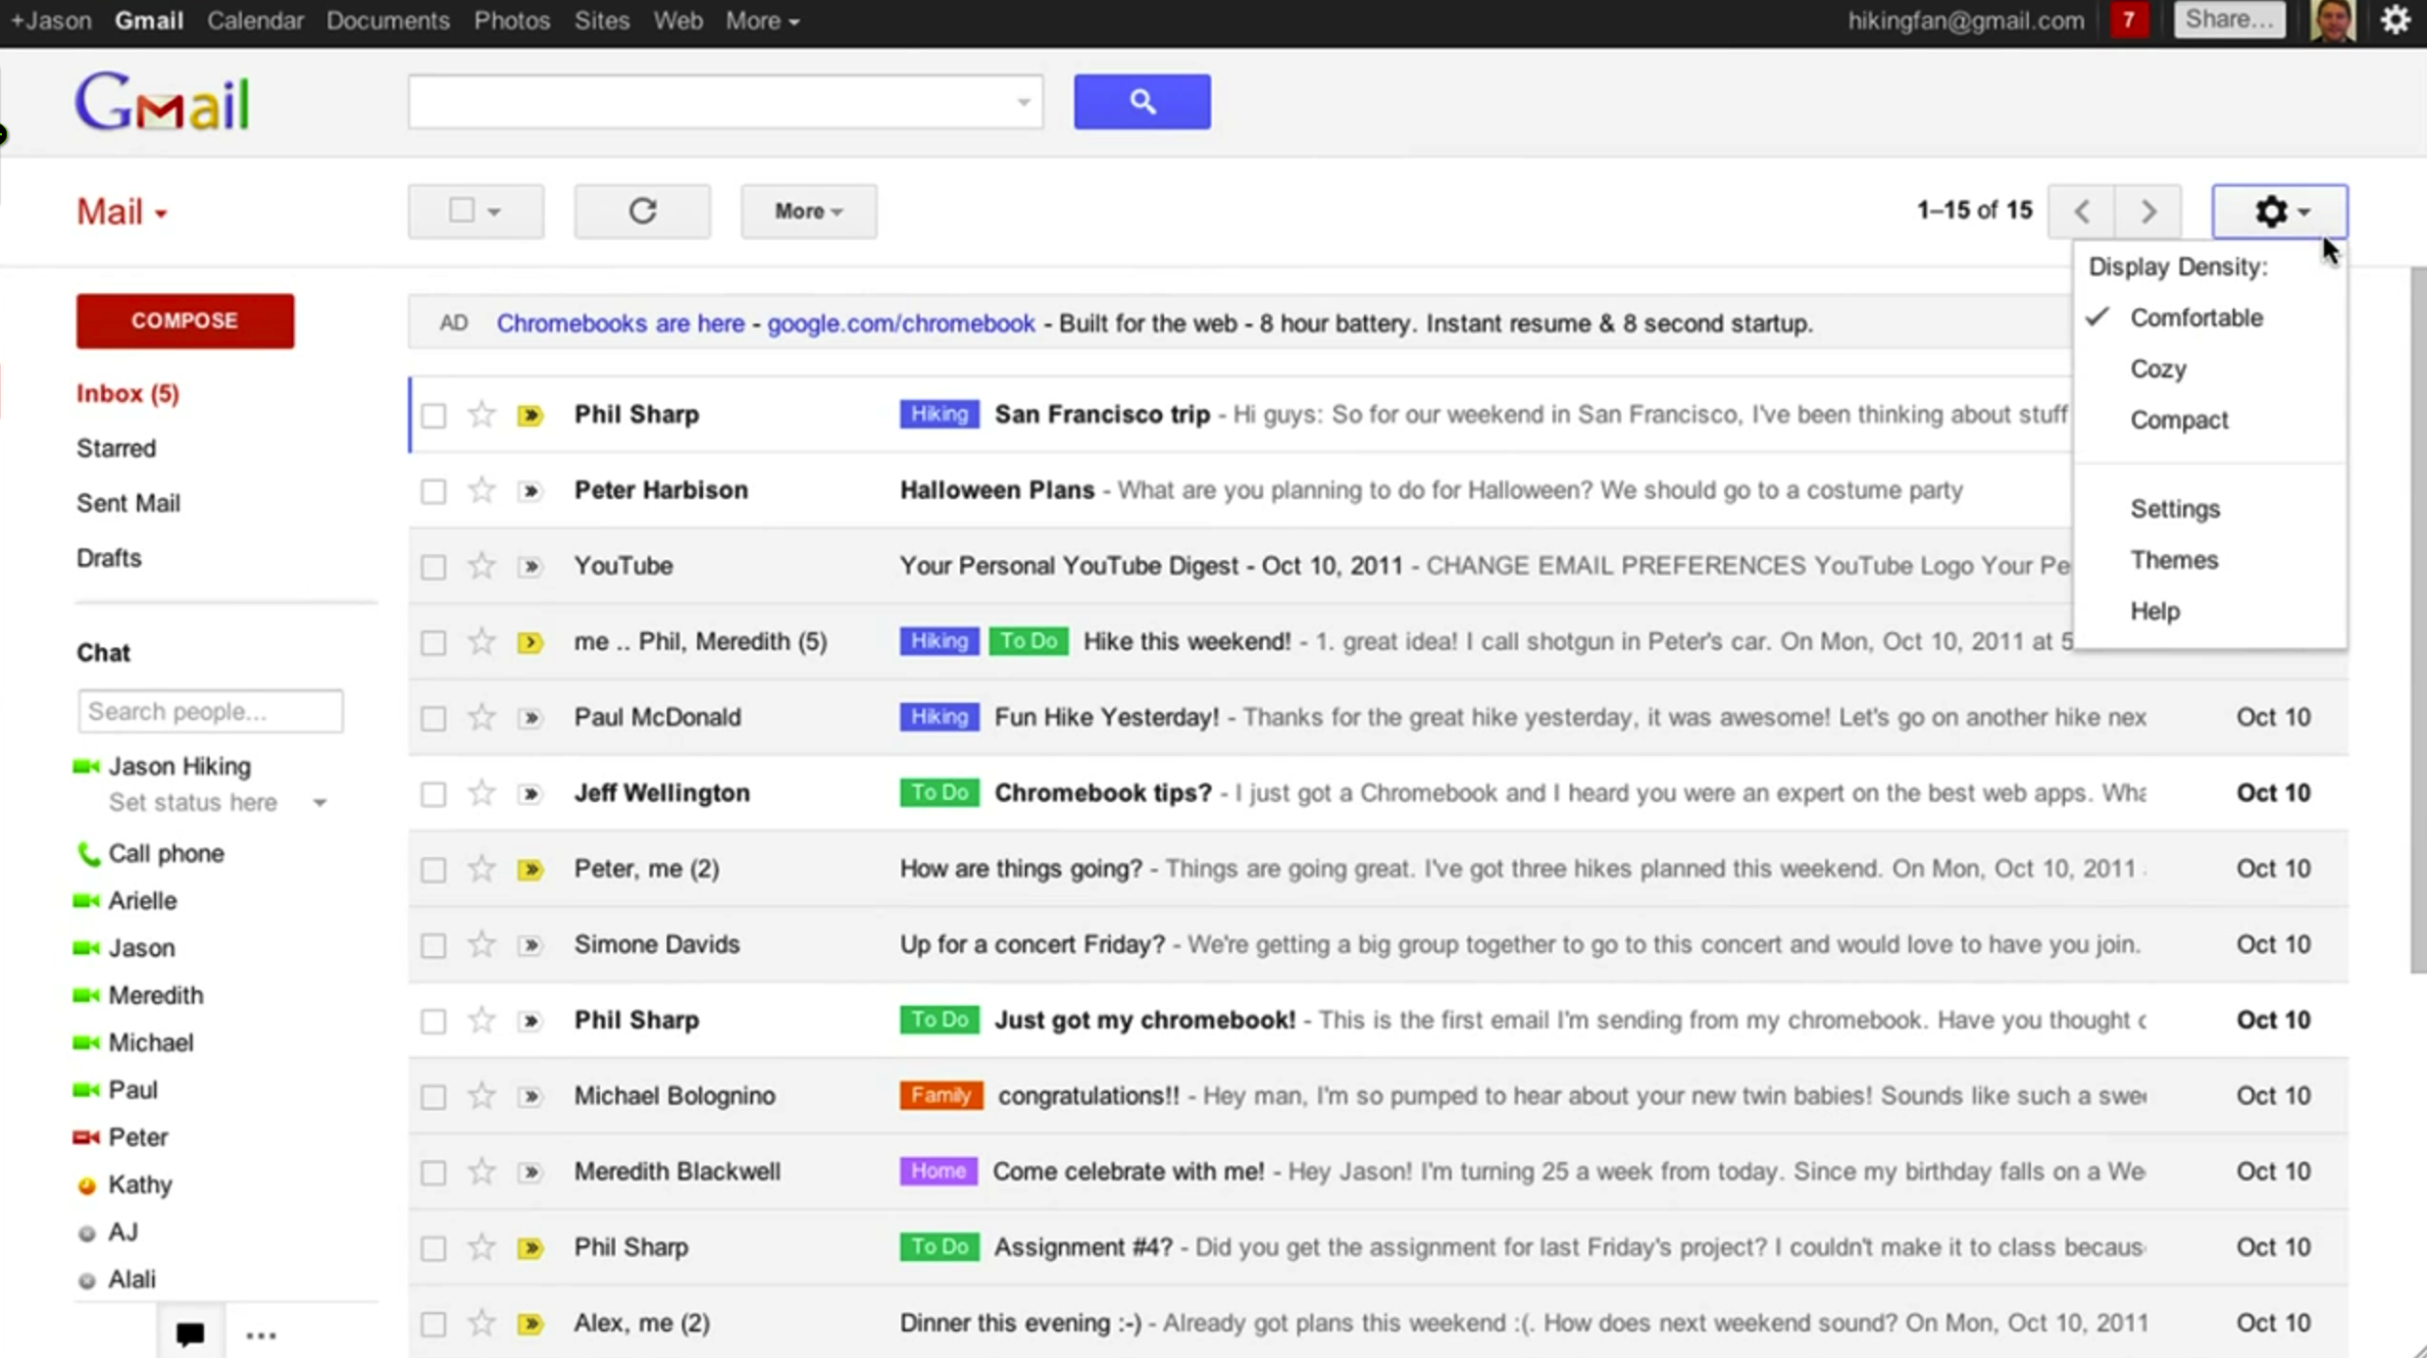
Gmail

Slide 6
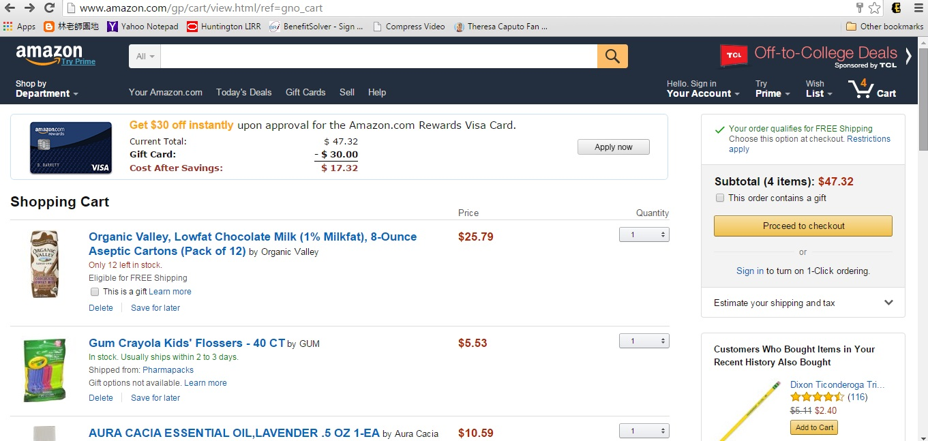
Amazon Shopping Cart

Slide 7
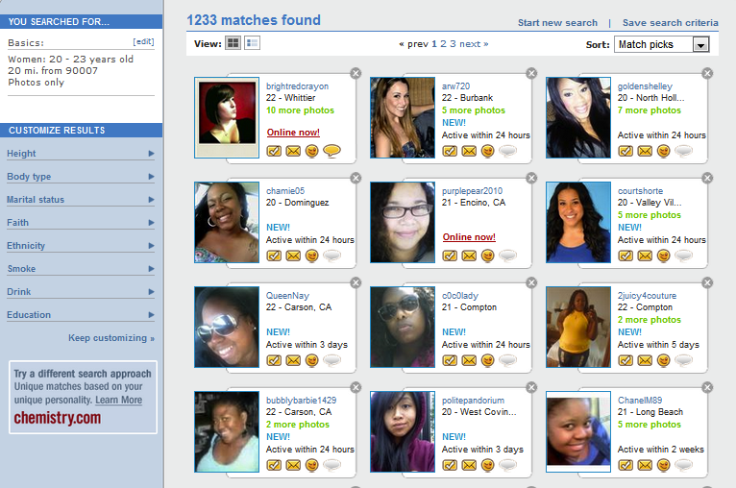
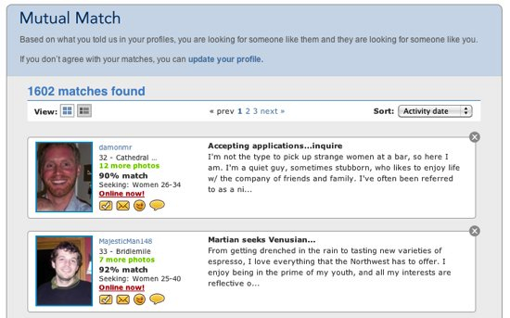
Match.com
Notes:
UX War, Match.com vs. OKCupid
http://www.trymyui.com/blog/2015/02/18/ux-wars-okcupid-vs-match-com/

Slide 8
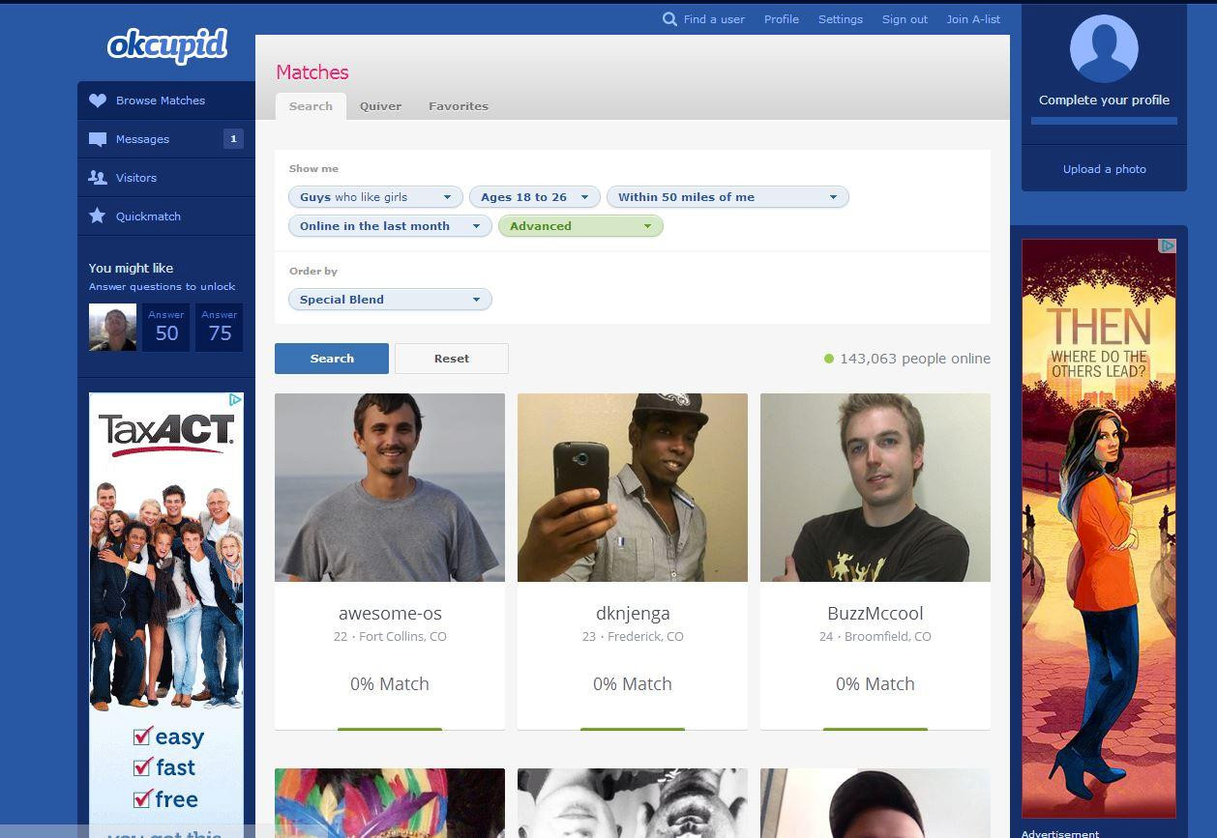
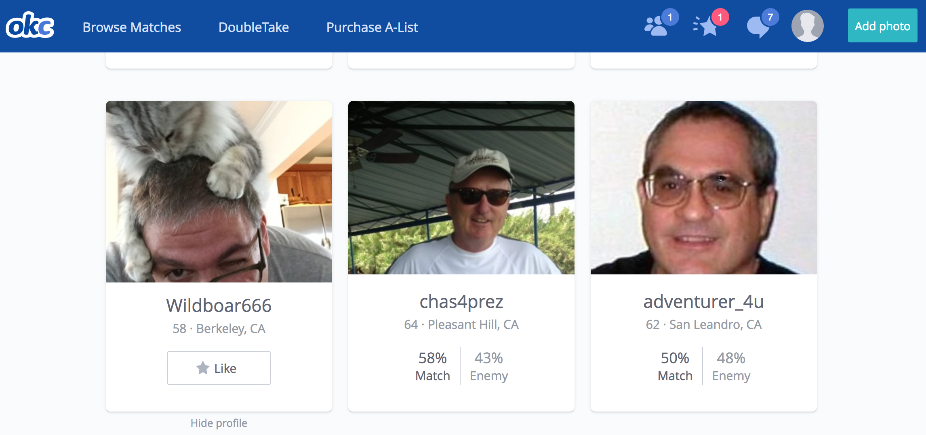
OKCupid

Slide 9
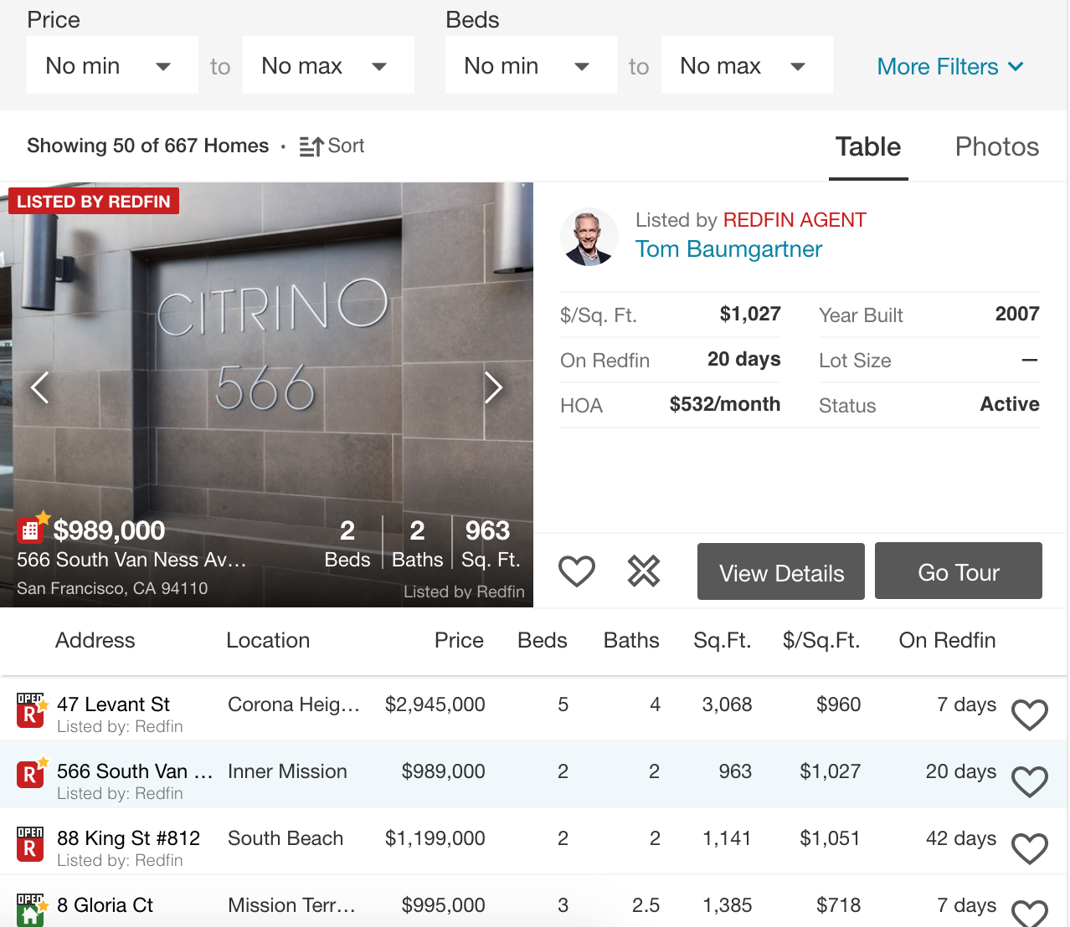
Redfin (Zillow, Trulia similar)

Slide 10
Matching & Filtering

Slide 11
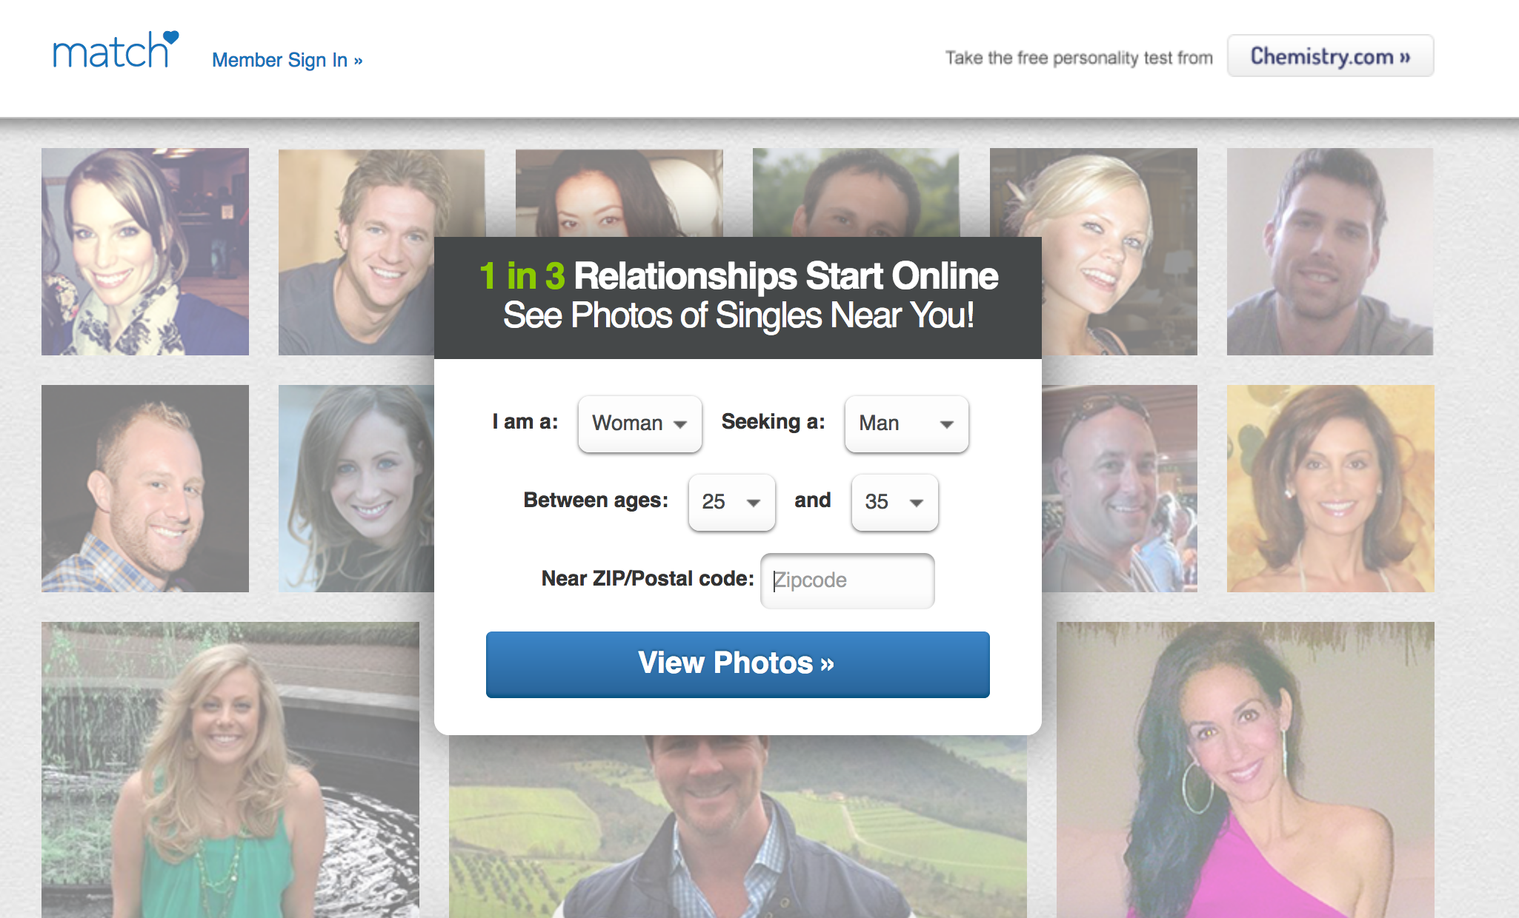

Slide 13
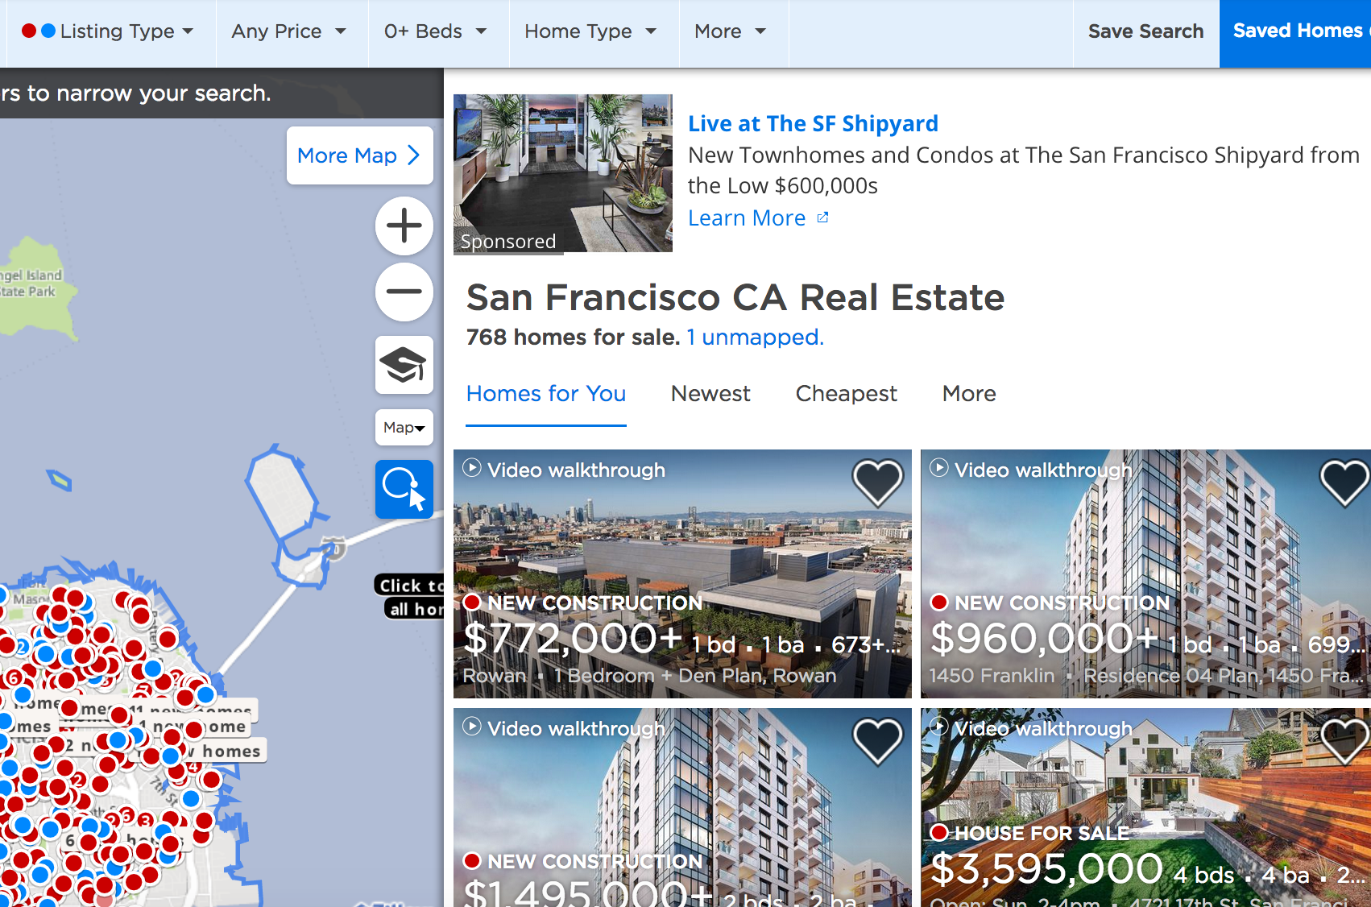

Slide 14
Other Inspirations
Craigslist
Kayak
Airbnb, Redfin/Zillow
Simbi, skillshare
Pandora
Tinder, Fiverr, The League, bumble
Onebrick.com (Calendar)
Idealist.org

